Slide 1

Lending Club - Credit Risk
Job Connector Data Science and Machine Learning Purwadhika Batch 7
Sapto Aji Pamungkas
Lending Club - Credit Risk

Slide 2

Highlight
Case Description
Data Introduction
Explanatory Data Analysis
Pre Modelling
Modelling
Model Evaluation
Conclusion

Slide 3
Case Description
Theme : Loan / Credit Risk
Company : Lending Club
Description : Lending Club is the world's largest peer-to-peer
lending platform which the product is enable
borrowers to create unsecured personal loan
between $1,000 and $40,000
Headquarters : San Fransisco, California, U.S
Constraint of Research : Individual Borrower and Transactions before
December 2015
Source of data
https://www.kaggle.com/janiobachmann/lending-club-risk-analysis-and-metrics/data

Slide 4
Data Introduction
Earliest Data :
74 Features, 886.868 Rows
Earliest Eliminated Features : 14 Features
'id', 'member_id', 'loan_amnt',‘ funded_amnt_inv', 'grade', 'emp_title', 'url', 'desc', 'zip_code', 'out_prncp_inv', 'total_pymnt_inv', 'title', 'policy_code', 'application_type',
Eliminated Features by Constraint of Research : 17 Features
'annual_inc_joint', 'dti_joint', 'verification_status_joint‘, 'open_acc_6m‘, 'open_il_6m', 'open_il_12m', 'open_il_24m', 'mths_since_rcnt_il', 'total_bal_il', 'il_util', 'open_rv_12m', 'open_rv_24m‘, 'max_bal_bc', 'all_util', 'inq_fi', 'total_cu_tl', 'inq_last_12m'

Slide 5
Data Introduction

Slide 6
Data Introduction

Slide 7
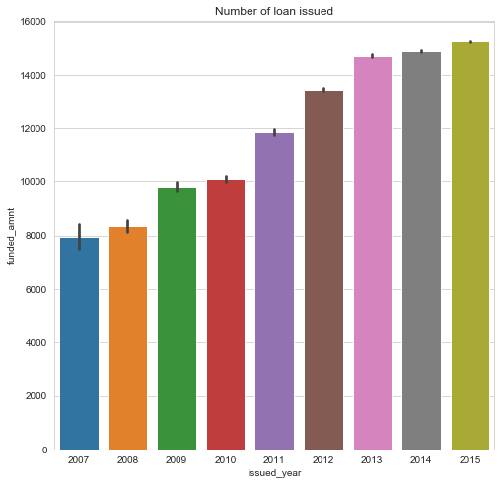
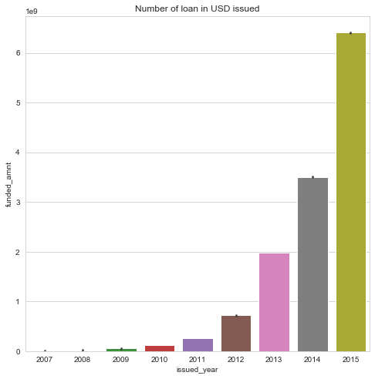
Explanatory Data Analysis

Slide 8
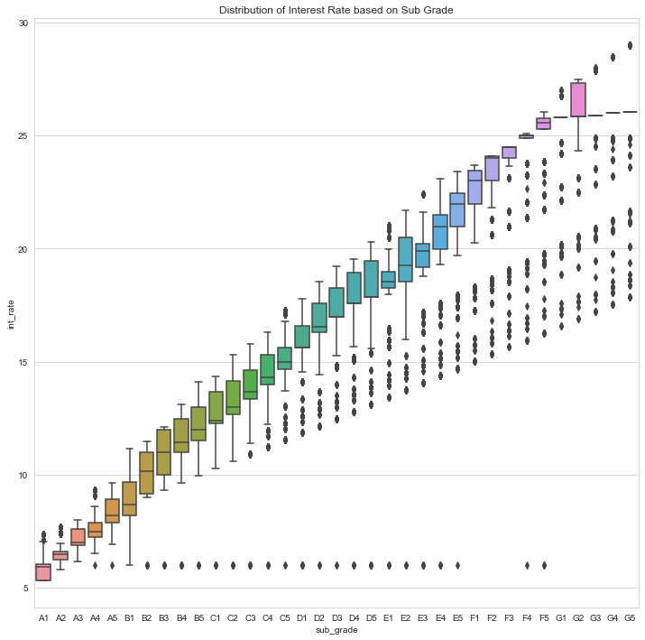
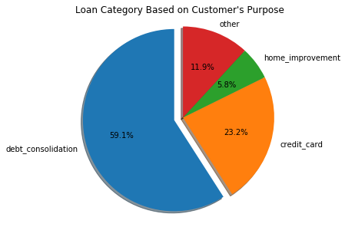
Explanatory Data Analysis

Slide 9
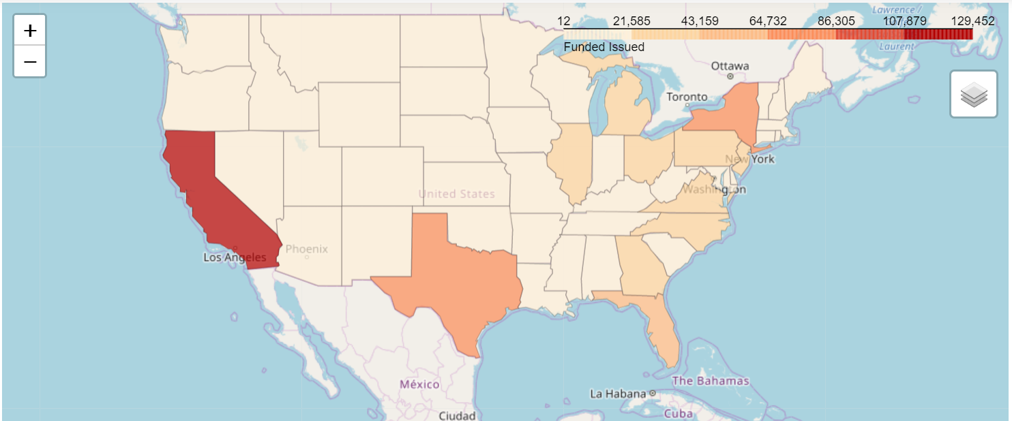
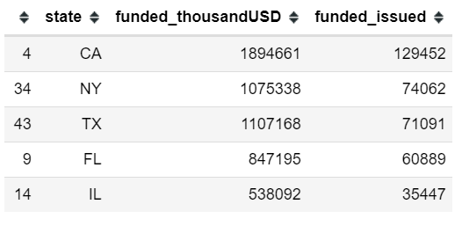
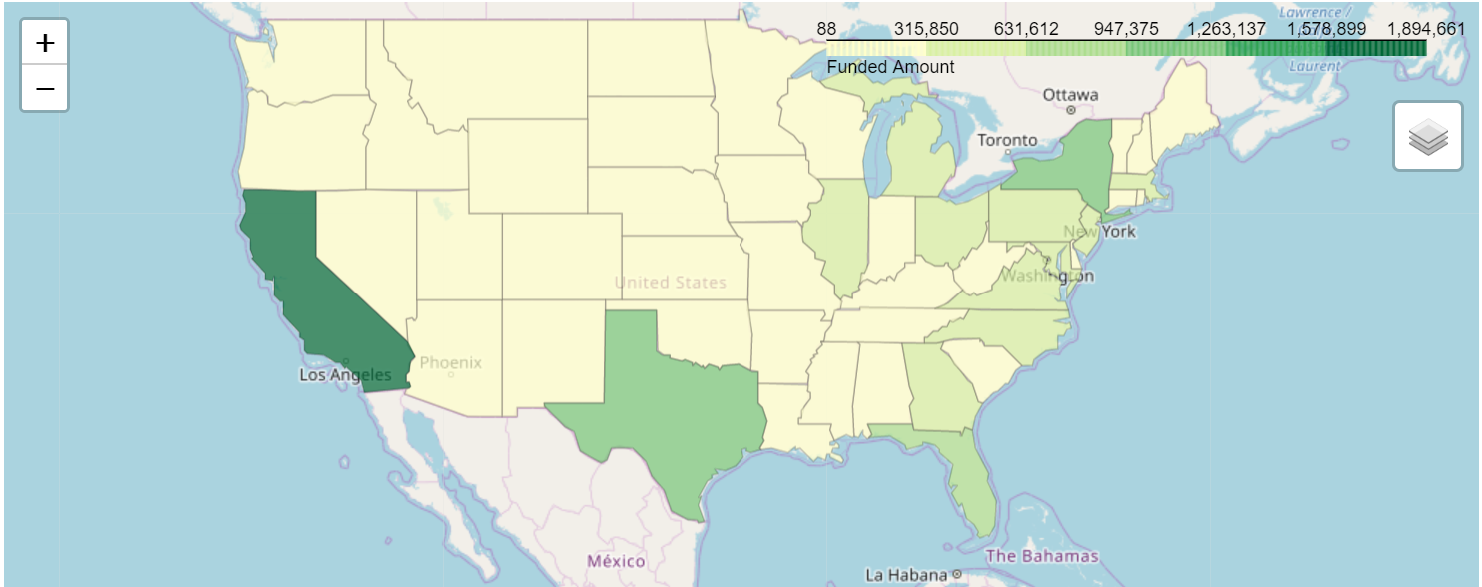
Explanatory Data Analysis

Slide 10
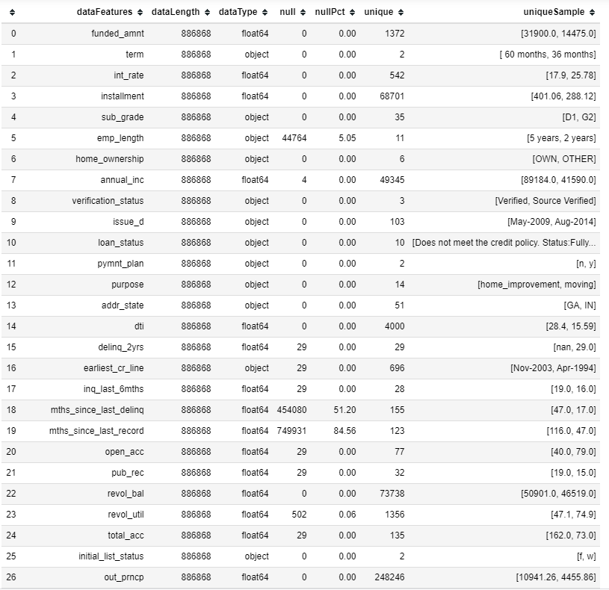
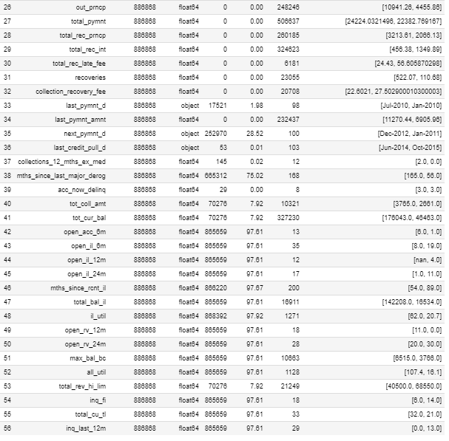
Handling Missing Values

Slide 11
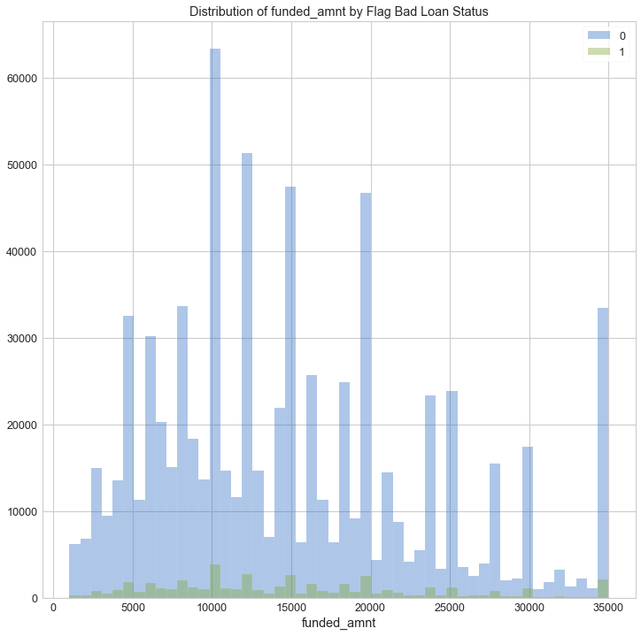
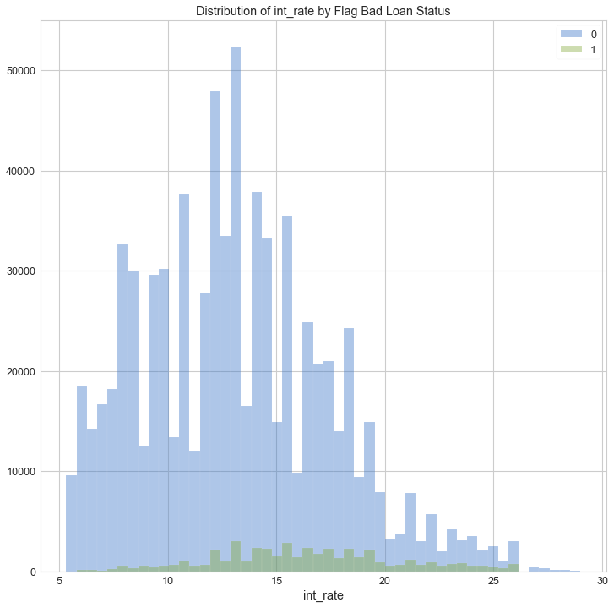
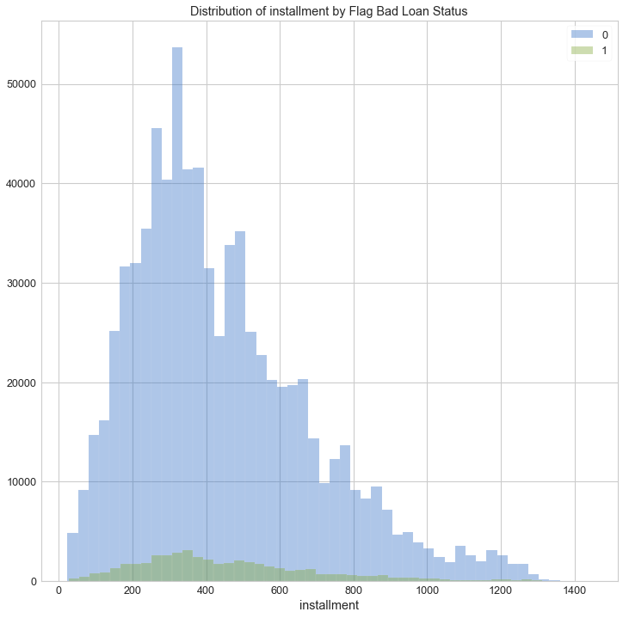
PRE-MODELLING (Numerical Features)
Feature : funded_amnt
Corr Ratio: 0.0039
Dist : Not-Normal
Feature : int_rate
Corr Ratio: 0.4308
Dist : Not-Normal
Feature : Installment
Corr Ratio: 0.0168
Dist : Not-Normal

Slide 12
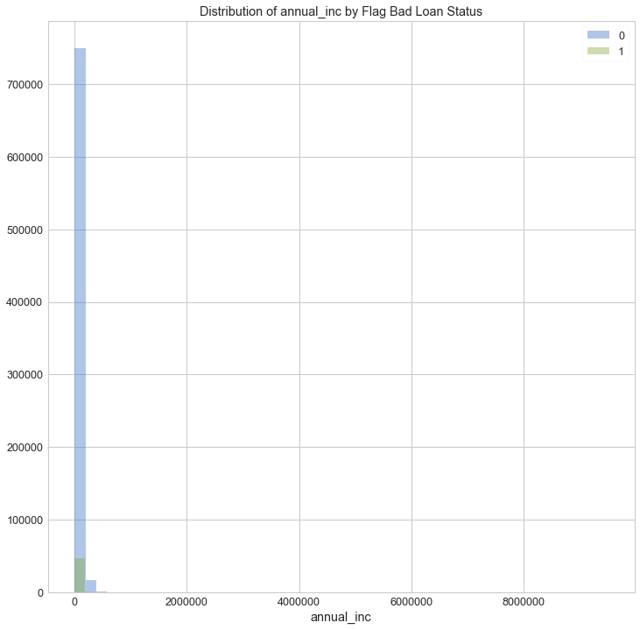
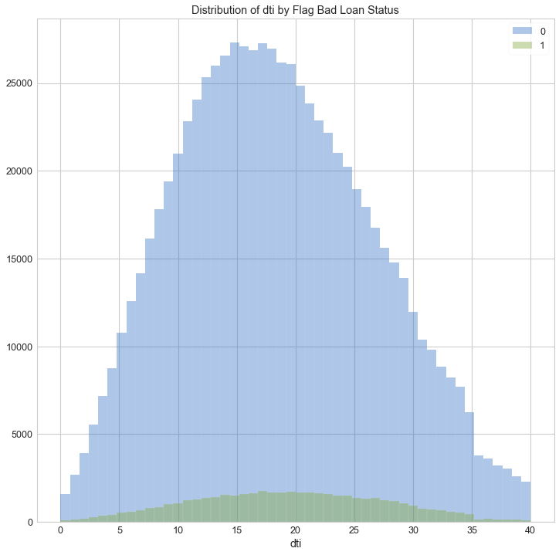
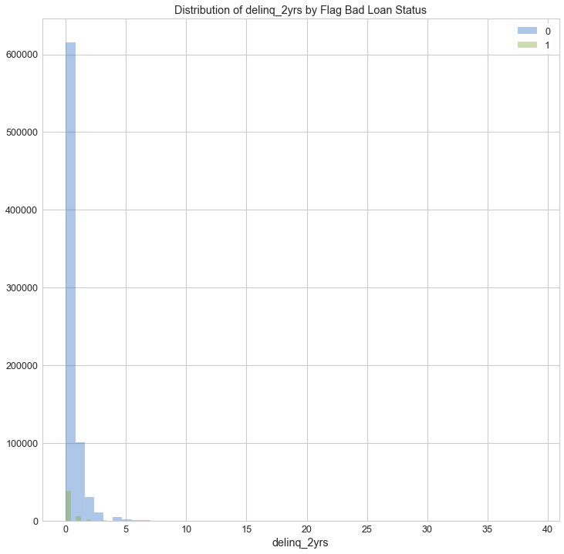
PRE-MODELLING (Numerical Features)
Feature : annual_inc
Corr Ratio: 0.033
Dist : Not-Normal
Feature : dti
Corr Ratio: 0.0296
Dist : Not-Normal
Feature : delinq_2yrs
Corr Ratio: 0.0005
Dist : Not-Normal

Slide 13
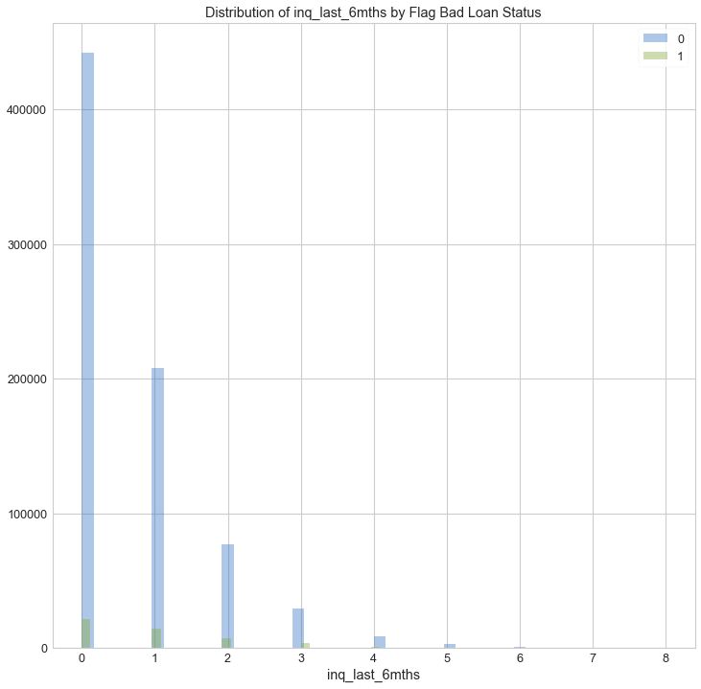
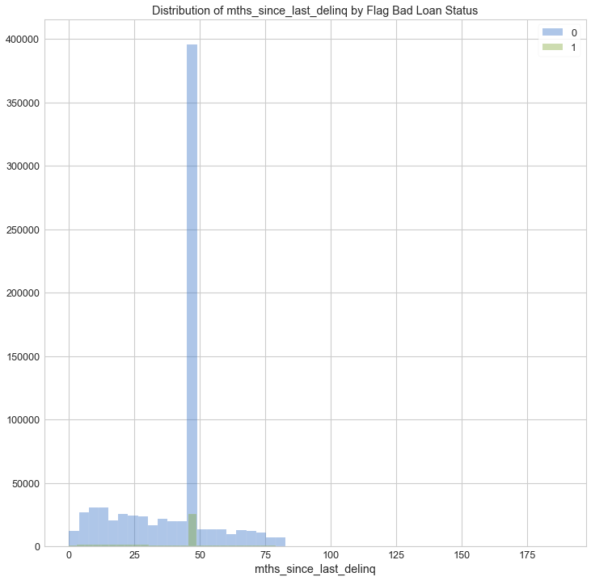
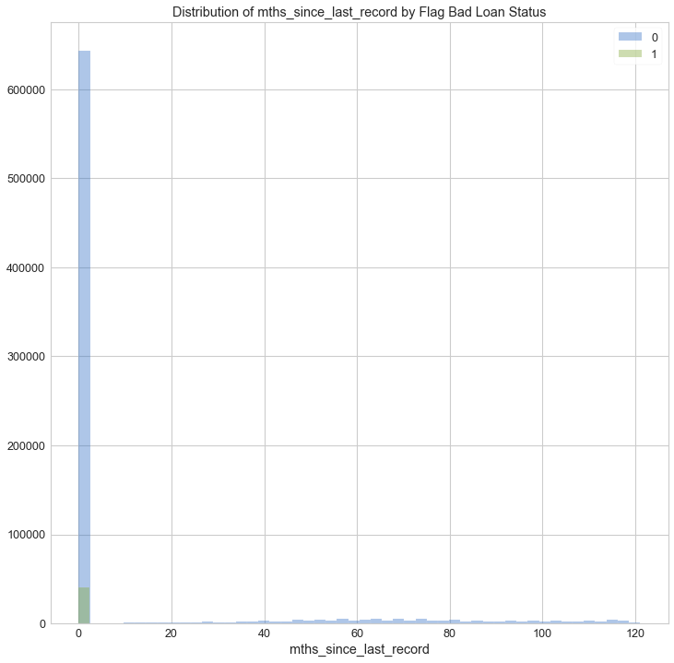
PRE-MODELLING (Numerical Features)
Feature : inq_last_6mths
Corr Ratio: 0.0705
Dist : Not-Normal
Feature : mths_since_last_delinq
Corr Ratio: 0.0002
Dist : Not-Normal
Feature : mths_since_last_record
Corr Ratio: 0.0008
Dist : Not-Normal

Slide 14
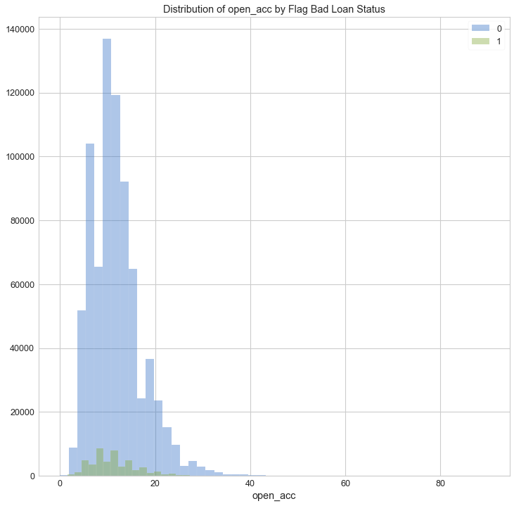

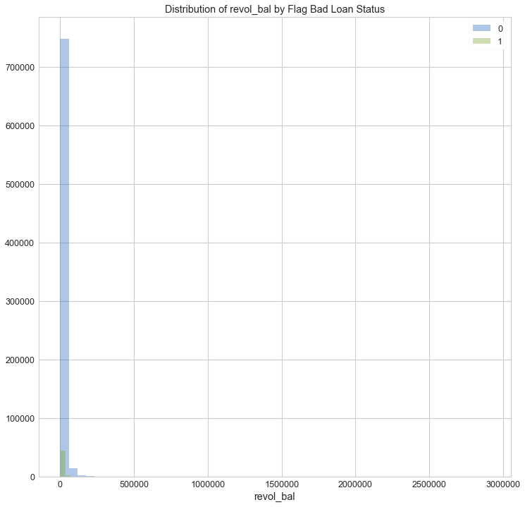
PRE-MODELLING (Numerical Features)
Feature : open_acc
Corr Ratio: 0.0095
Dist : Not-Normal
Feature : pub_rec
Corr Ratio: 0.0113
Dist : Not-Normal
Feature : revol_bal
Corr Ratio: 0.0197
Dist : Not-Normal

Slide 15
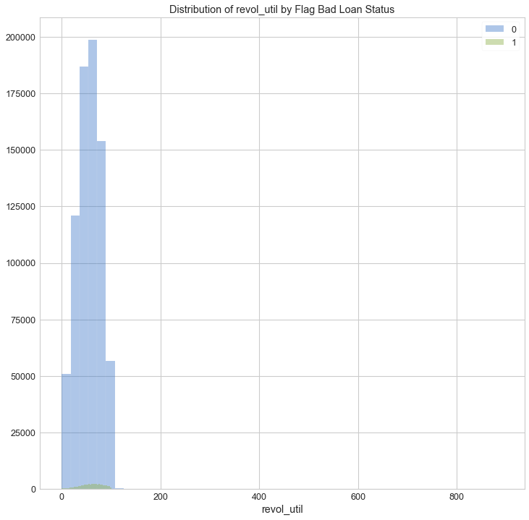
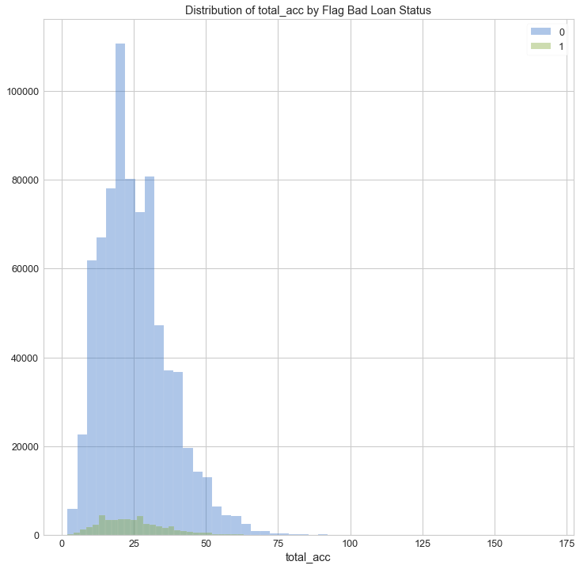
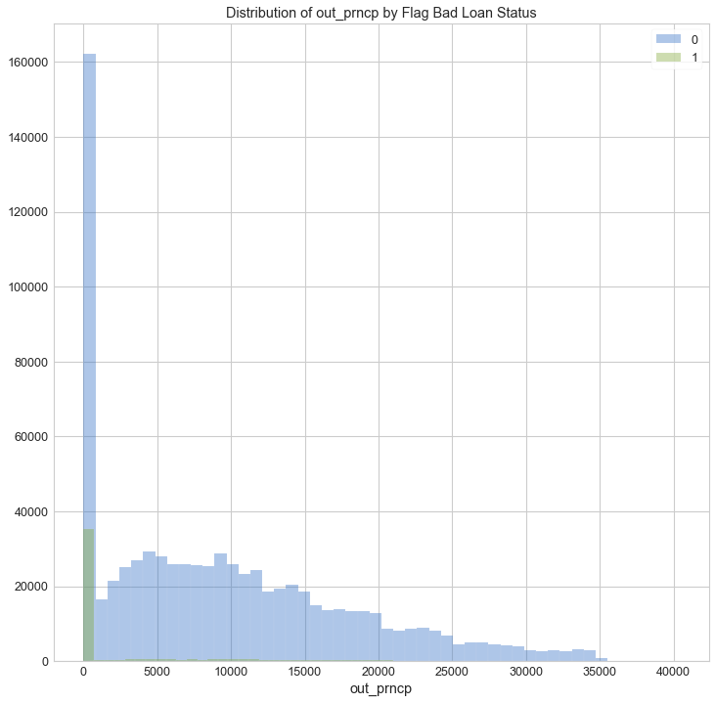
PRE-MODELLING (Numerical Features)
Feature : revol_util
Corr Ratio: 0.043
Dist : Not-Normal
Feature : total_acc
Corr Ratio: 0.0120
Dist : Not-Normal
Feature : out_prncp
Corr Ratio: 0.1763
Dist : Not-Normal

Slide 16
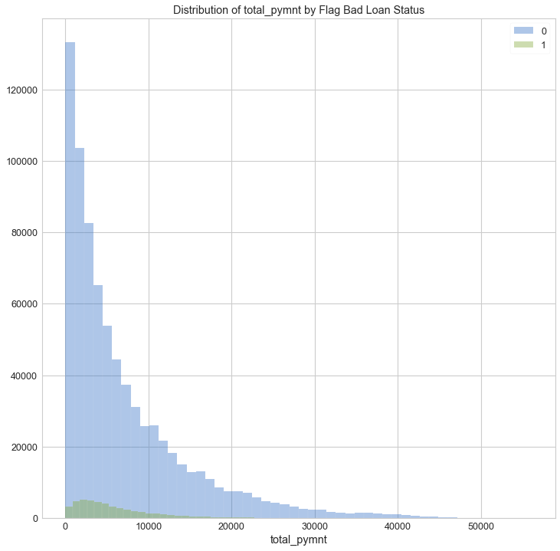
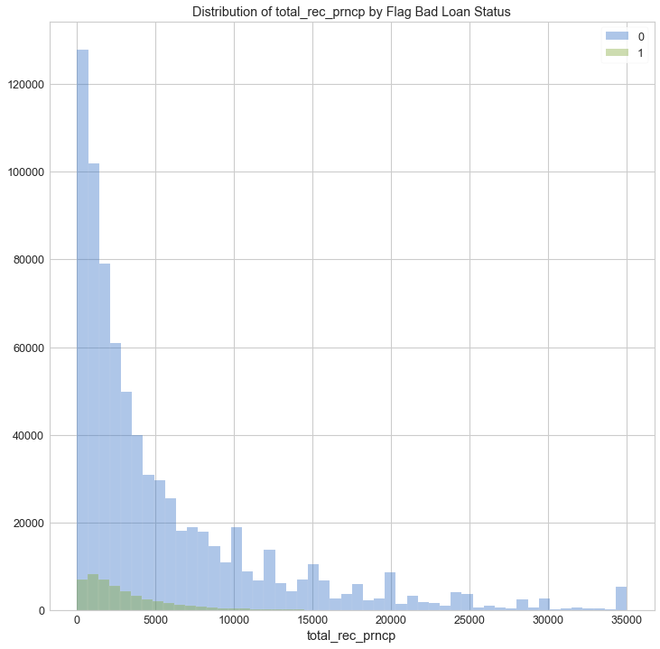
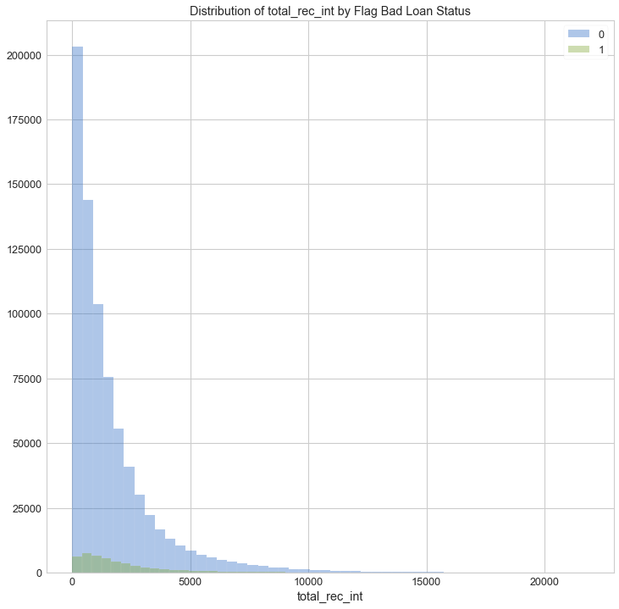
PRE-MODELLING (Numerical Features)
Feature : total_pymnt
Corr Ratio: 0.0330
Dist : Not-Normal
Feature : total_rec_prncp
Corr Ratio: 0.0825
Dist : Not-Normal
Feature : total_rec_int
Corr Ratio: 0.0588
Dist : Not-Normal

Slide 17
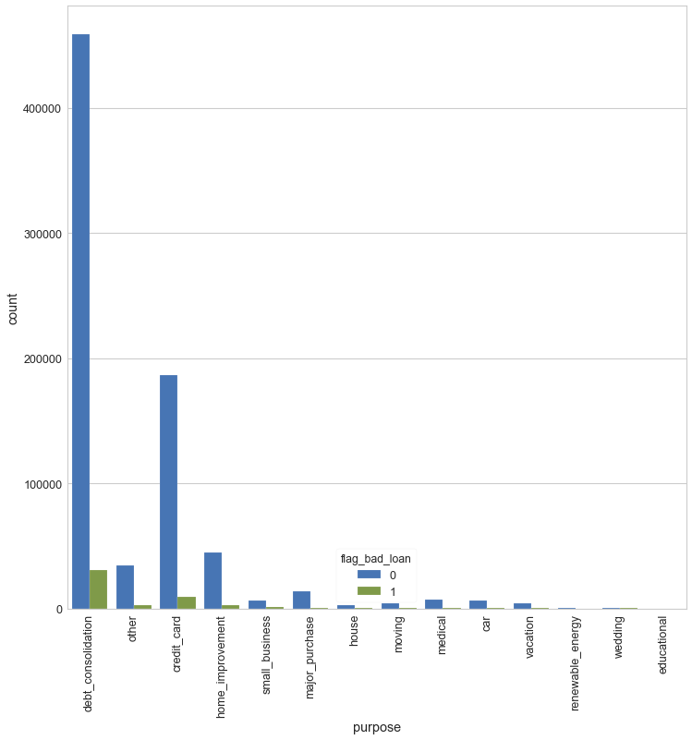
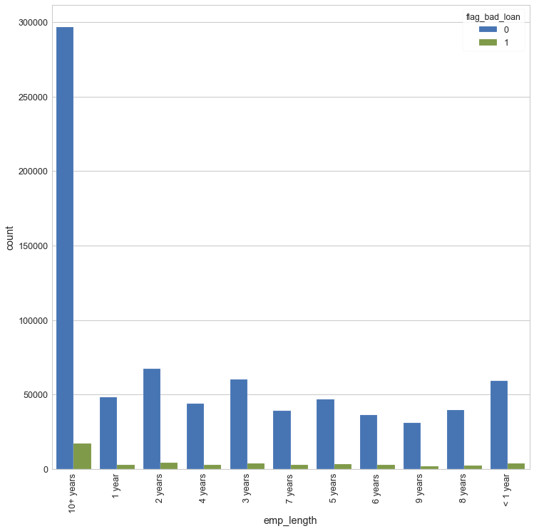
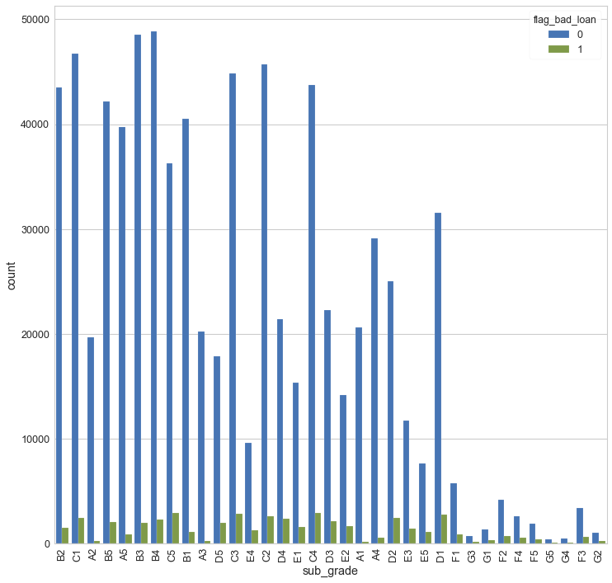
PRE-MODELLING (Categorical Features)
Feature : Purpose
Feature : Emp_length
Feature sub_grade

Slide 18
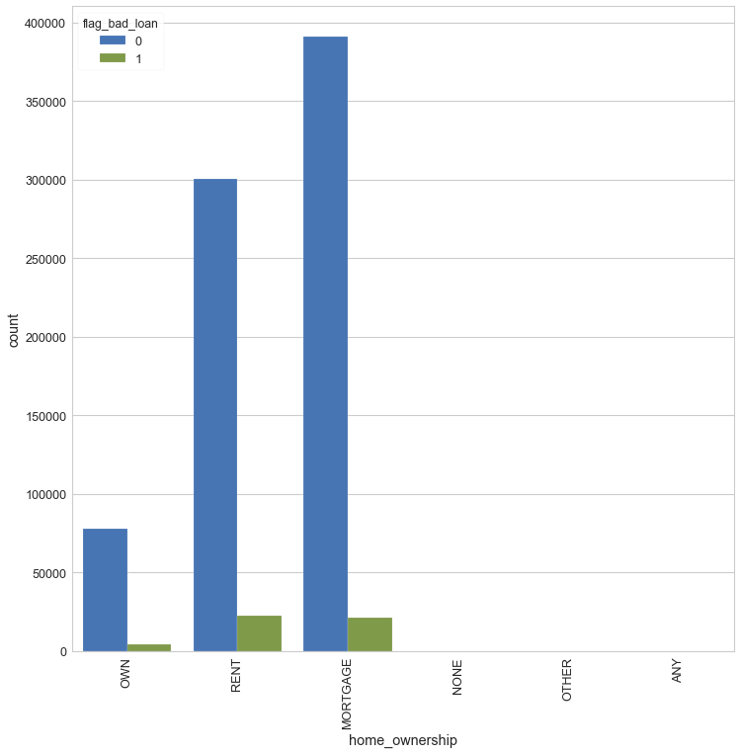
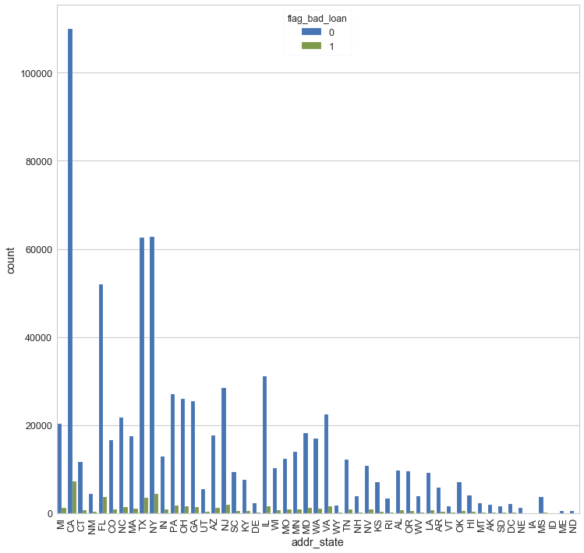
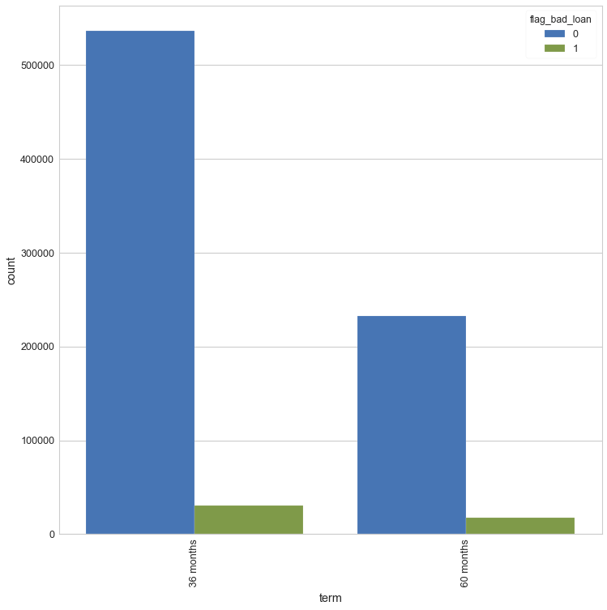
PRE-MODELLING (Categorical Features)
Feature : home_ownership
Feature : addr_state
Feature : term

Slide 19
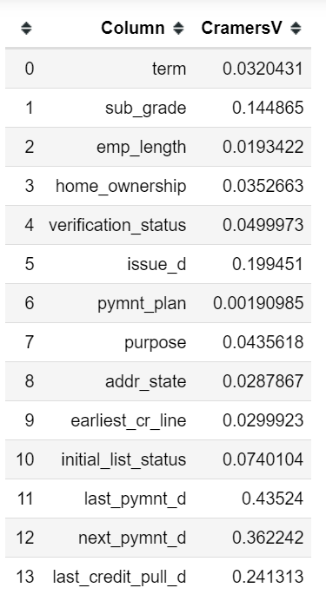
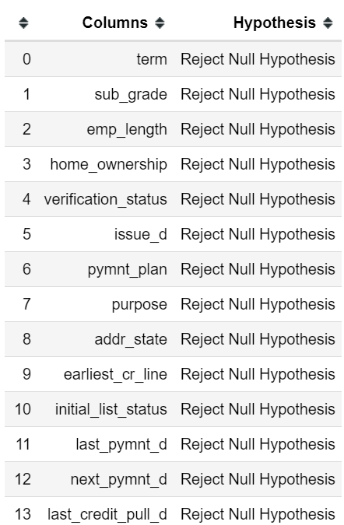
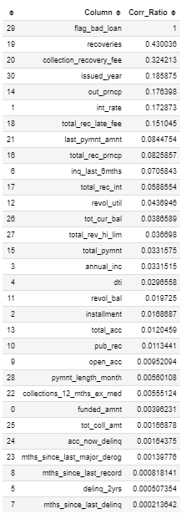
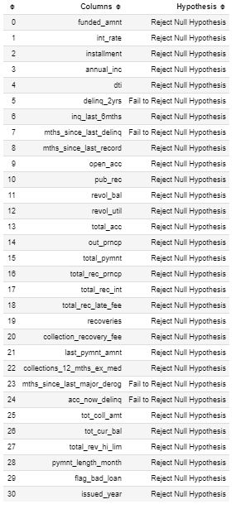
PRE-MODELLING (Hypothesis Testing for each Independent Variable)
Categorical Columns
Numerical Columns

Slide 20
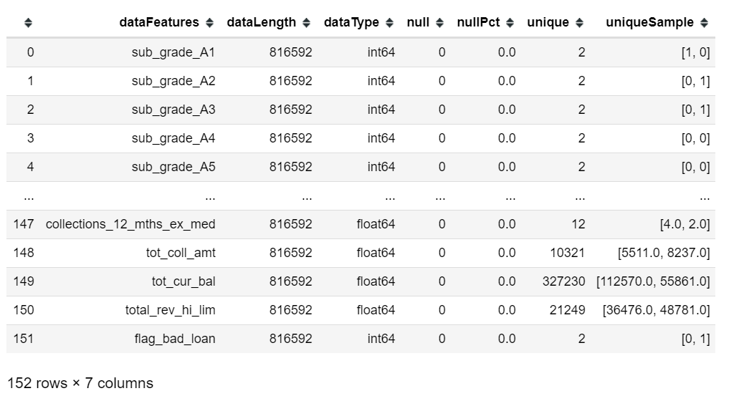
Pre-Modelling (Get Dummies of Categorical Columns, Drop Insignificant Independent Variables, Drop Independent Variable with High Multicolinnearity and Split into Train & Test Data )
Summary of Clean Data

Slide 21
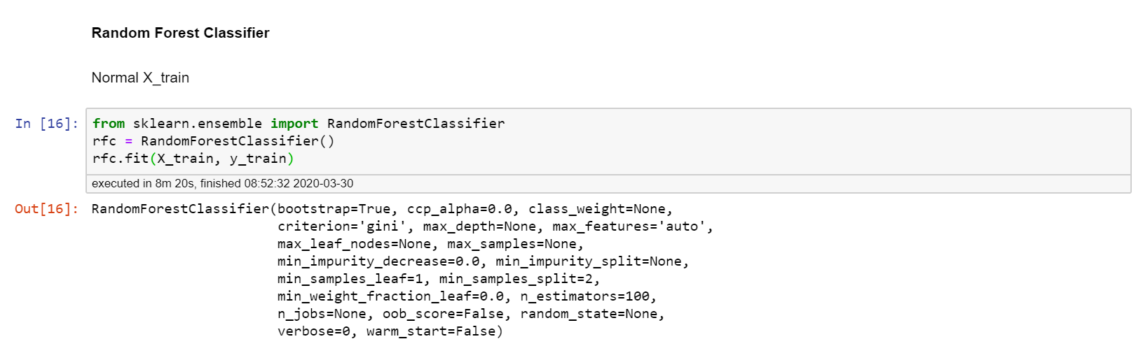
Modelling (Best Parameter)

Slide 22
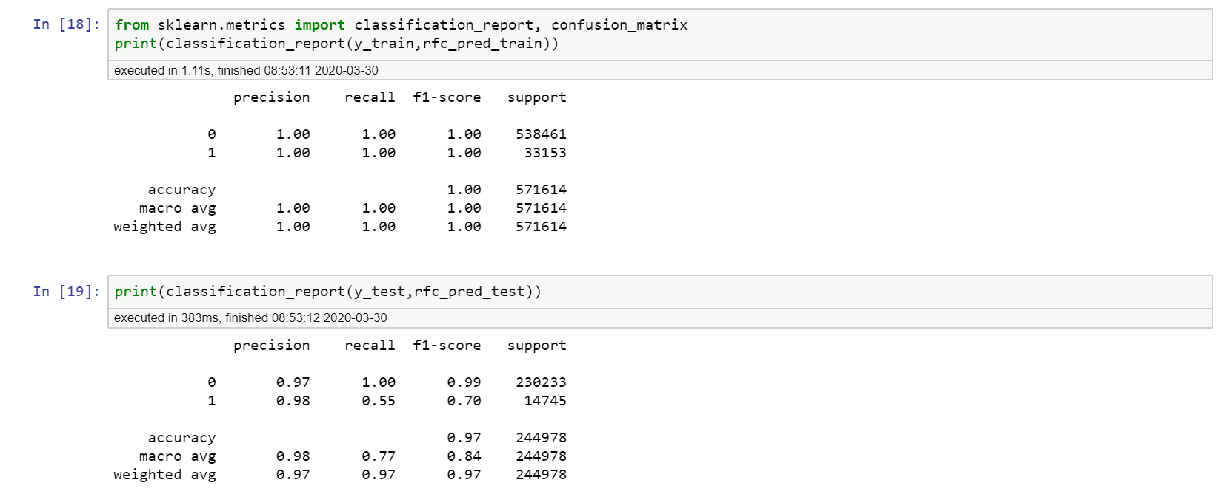
Model Evaluation (Best F1 Scores)

Slide 23
Conclusions

